Slide 1
Naïve Bayes
University of Science, VNU-HCMC Faculty of Information Technology Class: 17CLC-KHMT
Presenter:
1753086 – Tong le thien phuc
1753089 – Nguyen Ly Nhat PHuong

Slide 2



Contents
A Really Dumb Spam Filter
A More Sophisticated Spam Filter
Implementation
Testing Our Model

Slide 3
1.
A Really Dumb Spam Filter
Simple spam filter with Bayes’s Theorem

Slide 4

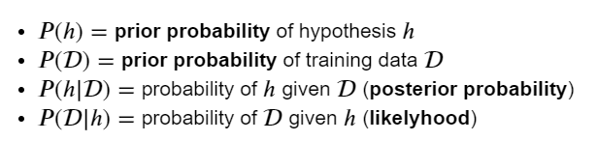
A Really Dumb Spam Filter

Slide 5

A Really Dumb Spam Filter
𝑆: The event “the message is spam”
𝑉: The event “the message contains the word viagra”
The probability that the message is spam conditional on containing the word viagra (proportion of viagra messages that are spam) is:

Slide 6

A Really Dumb Spam Filter
𝑆: The event “the message is spam”
𝑉: The event “the message contains the word viagra”
Assume that any message is equally likely to be spam or nonspam (𝑃(𝑆)=𝑃(¬𝑆)=0.5 ) then:

Slide 7

A Really Dumb Spam Filter
𝑆: The event “the message is spam”
𝑉: The event “the message contains the word viagra”
Example: If 50% of spam messages have the word viagra, but only 1% of nonspam messages do, then the probability that any given viagra-containing email is spam is:

Slide 8
2.
A More Sophisticated Spam Filter
Upgrade spam filter with Naïve Bayes

Slide 9
A More Sophisticated Spam Filter
Vocabulary of many words 𝑤1,...,𝑤𝑛
𝑋𝑖 : The event “a message contains the word 𝑤𝑖”
The probability that a spam message contains the 𝑖 th word: 𝑃(𝑋𝑖|𝑆)
The probability that a nonspam message contains the 𝑖 th word: 𝑃(𝑋𝑖|¬𝑆)
Naïve Bayes make assumption that the presences (or absences) of each word are independent of one another, conditional on a message being spam or not:

Slide 10
A More Sophisticated Spam Filter
Example: The vocabulary consists only of the words “viagra” and “rolex,” and that half of all spam messages are for “cheap viagra” and that the other half are for “authentic rolex”. The Naive Bayes estimate that a spam message contains both “viagra” and “rolex” is:
Assume that “viagra” and “rolex” actually never occur together.

Slide 11
A More Sophisticated Spam Filter
Example: The “viagra-only” spam filter:

Slide 12
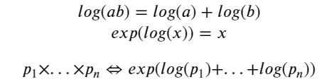
A More Sophisticated Spam Filter
Problem:
Underflow

Slide 13
A More Sophisticated Spam Filter
Problem:
Word only occur in spam/nonspam messages.
Choose a pseudocount k and estimate the probability of seeing the i th word in spam and nonspam:

Slide 14
3.
Implementation
Implement the model

Slide 15
Implementation
Tokenize messages into distinct words:

Slide 16
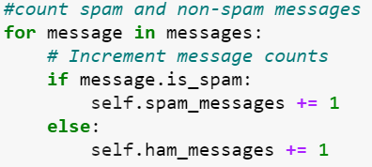
Implementation
Count spam and nonspam (ham) messages:

Slide 17
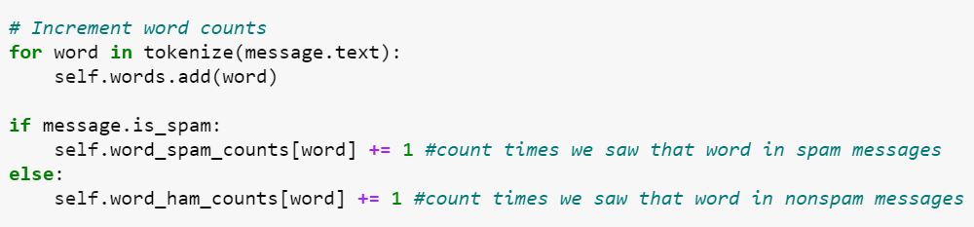
Implementation
Count words in spam and nonspam (ham) messages:

Slide 18
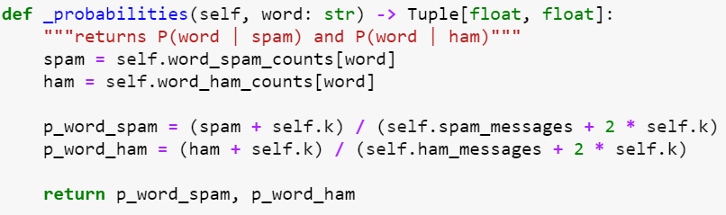
Implementation
Calculate word probabilities:

Slide 19
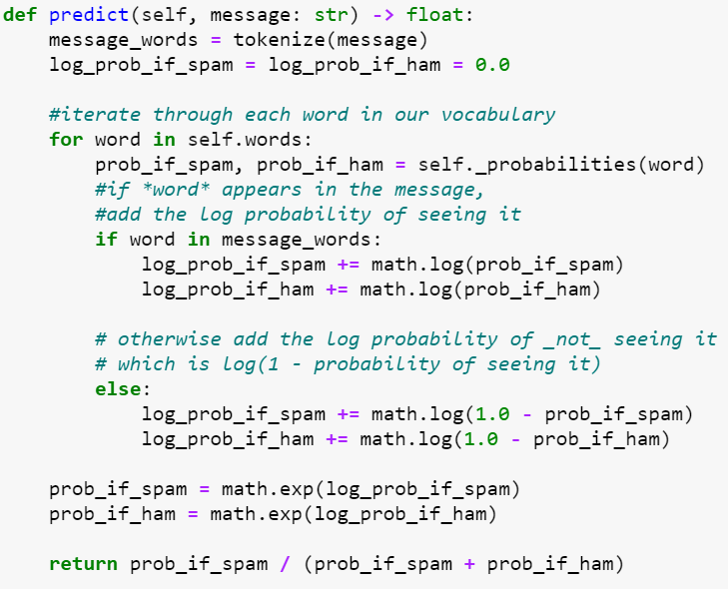
Implementation
Use word probabilities to assign probabilities to messages:

Slide 20
4.
Testing Our Model
Test the model with given data set

Slide 21
Testing Our Model
Data Description: SpamAssassin public corpus dataset
Split into three parts:
spam: 501 spam messages, all received from non-spam-trap sources.
easy_ham: 2551 non-spam messages. These are typically quite easy to differentiate from spam.
hard_ham: 250 non-spam messages which are closer in many respects to typical spam.
Total count: 3302 messages, with about a 15% spam ratio.

Slide 22
Testing Our Model
Read data: Just use subject lines of each email.

Slide 23
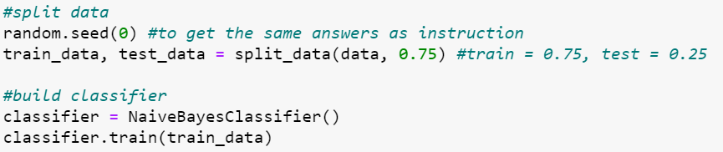
Testing Our Model
Split data and train model:

Slide 24
Testing Our Model
Predict and evaluate model:

Slide 25

Testing Our Model
Predict and evaluate model:

Slide 26

Testing Our Model
Result with no smooth:

Slide 27
Testing Our Model
Look for spammiest words and hammiest words:

Slide 28

Testing Our Model
Optimization:
Look at the message content, not just the subject line.
Modify the classifier to accept an optional min_count threshhold and ignore tokens that don’t appear at least that many times.
Modify the classifier to take an optional stemmer function that converts words to equivalence classes of words

Slide 29
THANK YOU FOR LISTENING
?

